Slide 1
We help your organization become data driven

Slide 2
Drug adverse event monitoring with Tableau

Slide 3
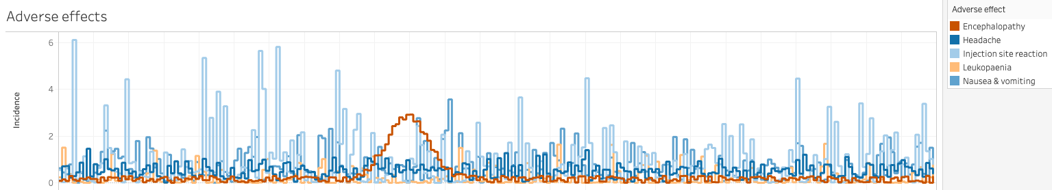
Drug adverse event monitoring with Tableau
Typically, patients taking a medication may exhibit a range of side effects.
These typically exhibit three patterns over time:
Uniform: occur regardless of treatment duration with a relatively constant frequency
Accumulative: occur with increasing risk as the duration of treatment progresses
Spike events: in an insolated group of patients, these events occur after a certain amount of time.
Identifying spike events (in this case, encephalopathy) can assist in tailoring maximum treatment duration and avoiding ADRs.

Slide 4
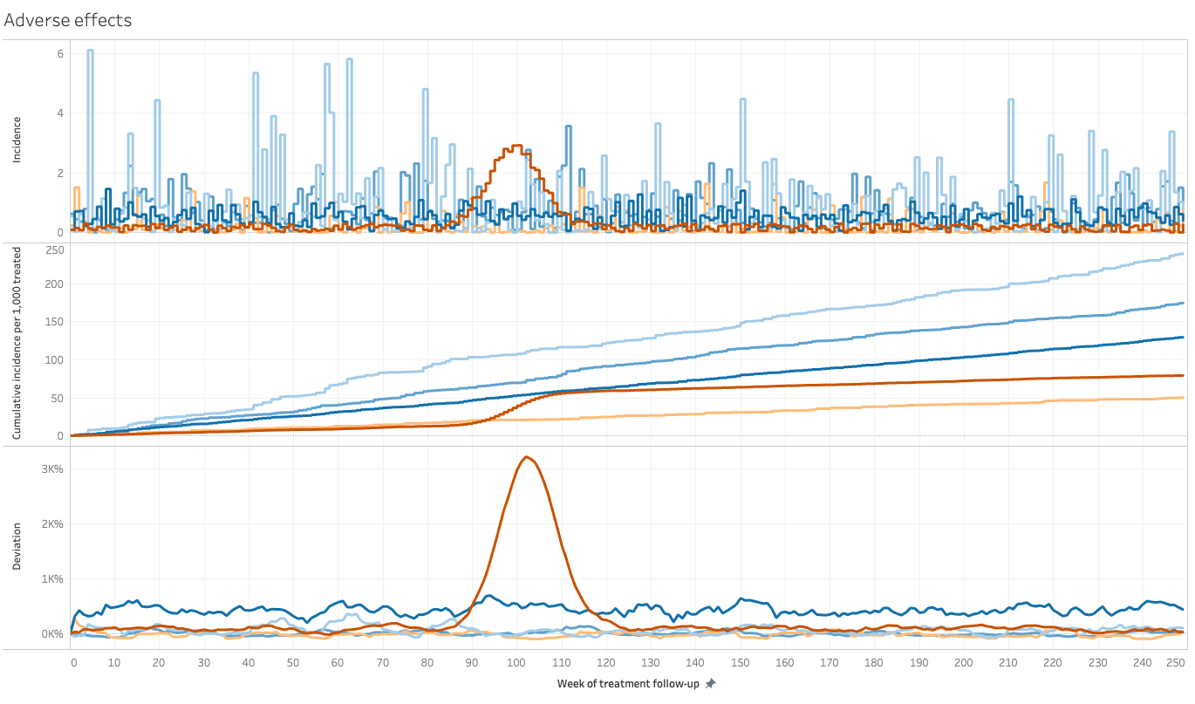
Indication of anomalous behaviour

Slide 5
COVID-19: a tale of three states

Slide 6
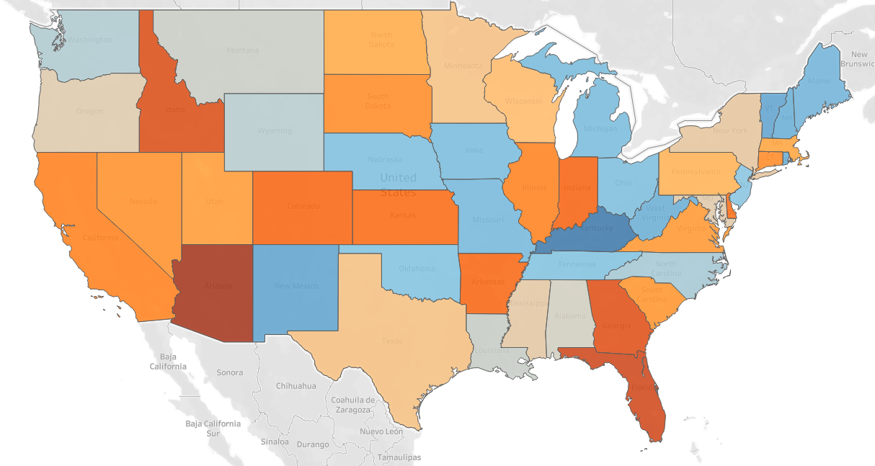
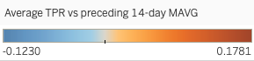
COVID-19: a tale of three states
Populations have responded differently to the COVID-19 pandemic. Spatial analysis in Tableau can help in the analysis of approaches to managing the pandemic.
By analysing test positivity ratios (positive tests as fraction of all tests conducted), we can identify various patterns of disease dynamics, and extrapolate future outcomes.
We can then cross-correlate this with changes in mobility characteristics of the underlying population.
Tableau makes it convenient to display and analyse this data dynamically.

Slide 7
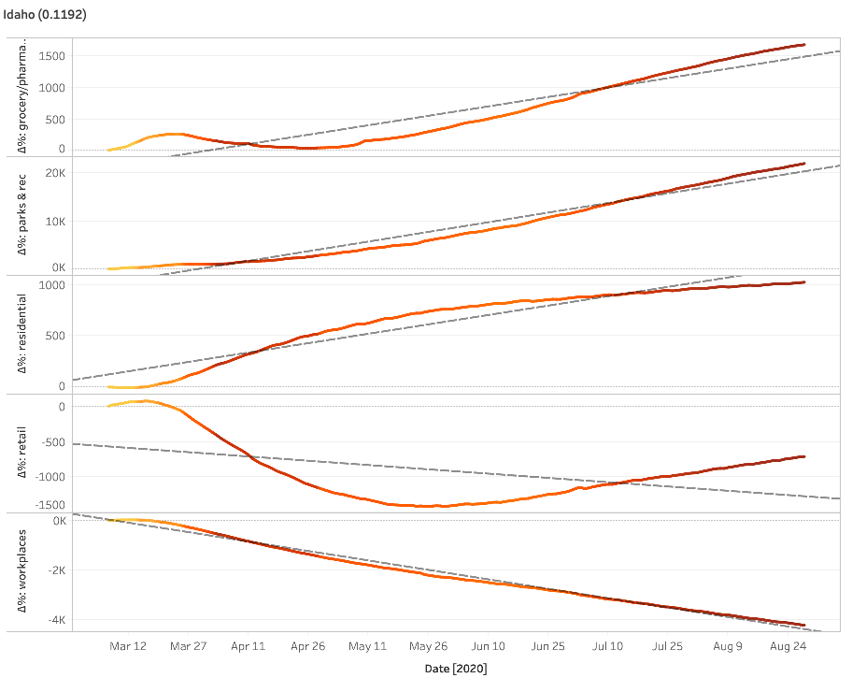
COVID-19: a tale of three states
Some states, such as Idaho (see left), have enacted relatively modest measures of social distancing.
While workplaces remain largely less visited and retail is significantly less than it was in early March, grocery/pharmacy visits and visits to parks and recreational facilities has rebounded.
As a consequence, as the colour of the line indicates (darker = higher test positivity ratio), test positivity ratios have increased.

Slide 8
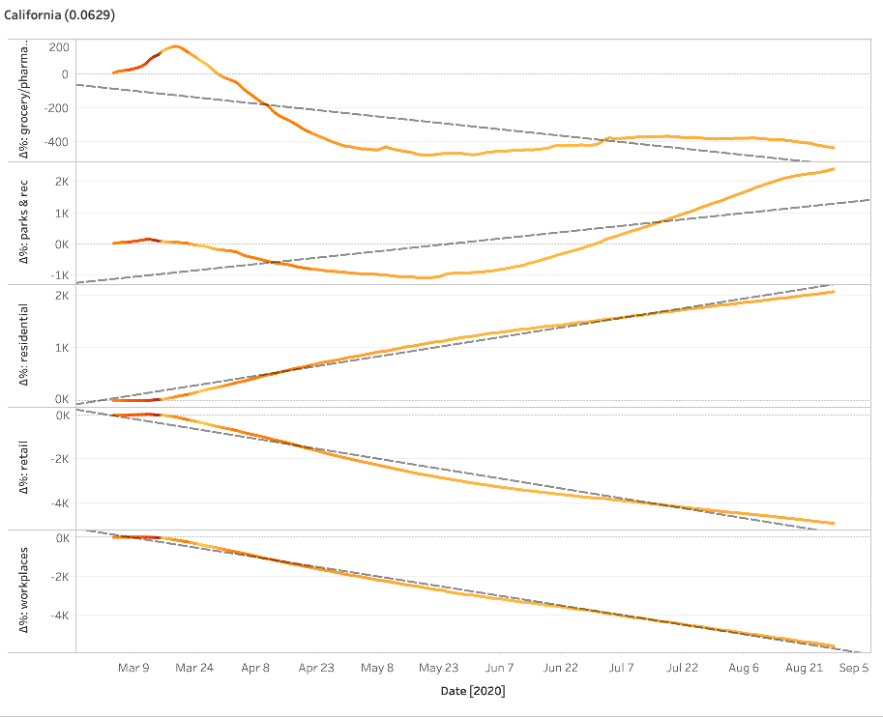
COVID-19: a tale of three states
California (see left) is an example of an early case of effective strict management: a strong reduction in retail and workplaces has led to a relatively low case positivity ratio.
The effect of early quarantines (March-April) is particularly visible: residental attendance (stay-at-home) increases while retail, workplaces and grocery/pharmacy related mobility drop sharply. By late April/early May, the effects of this are visible as a decrease in test positivity ratios.

Slide 9
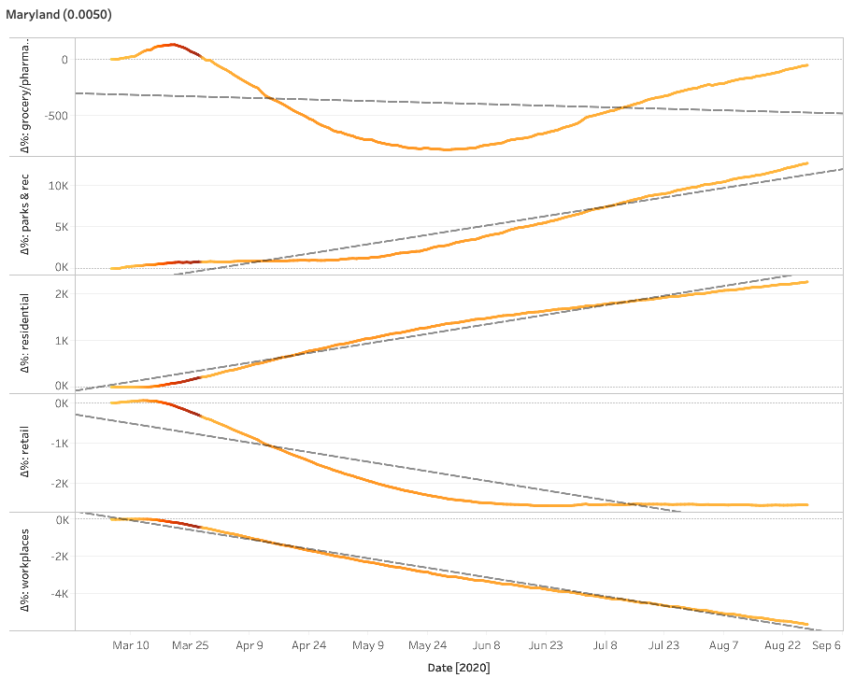
COVID-19: a tale of three states
In Maryland, early high test positivity ratios in March have led to rapid decreases.
By late May, the test positivity ratio has decreased, and by July, a bounce-back has started, especially for the grocery/pharmacy sector.
Around the same time, the decline of retail attendance flattened and residential attendance began to slowly taper off.

Slide 10
Time series forecasting in Tableau

Slide 11
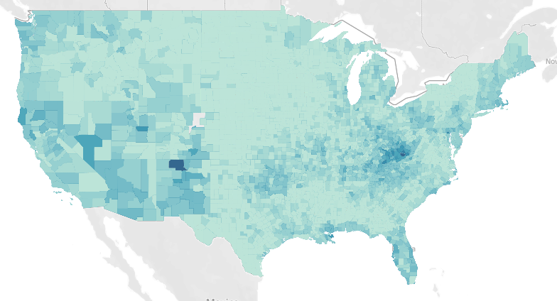
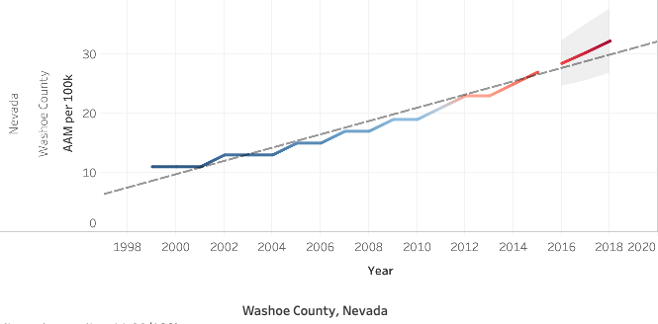
Time series forecasting in Tableau
Tableau's built-in time series forecasting capabilities can create forecasts from time series based on a linear model.
This visualisation shows a county-level breakdown of age-adjusted mortality from drug poisoning, 1998-2015, based on data from the CDC's National Center for Health Statistics, per 100k age-adjusted normal population.
In the inlay, data to 2015 is extrapolated to yield a forecast from 2016 onwards by fitting a linear model.

Slide 12
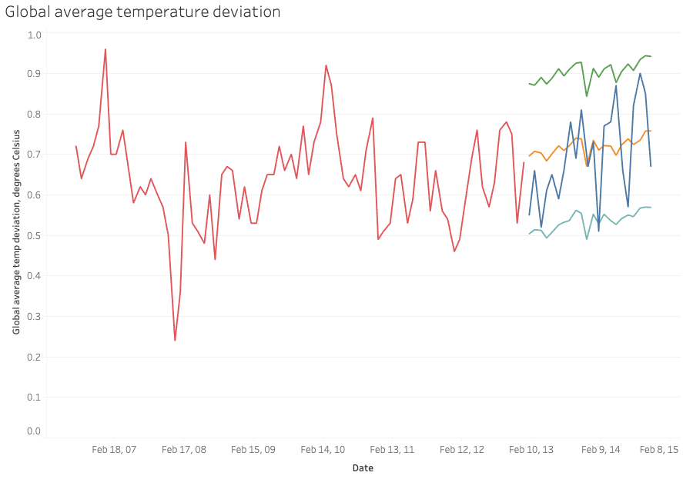
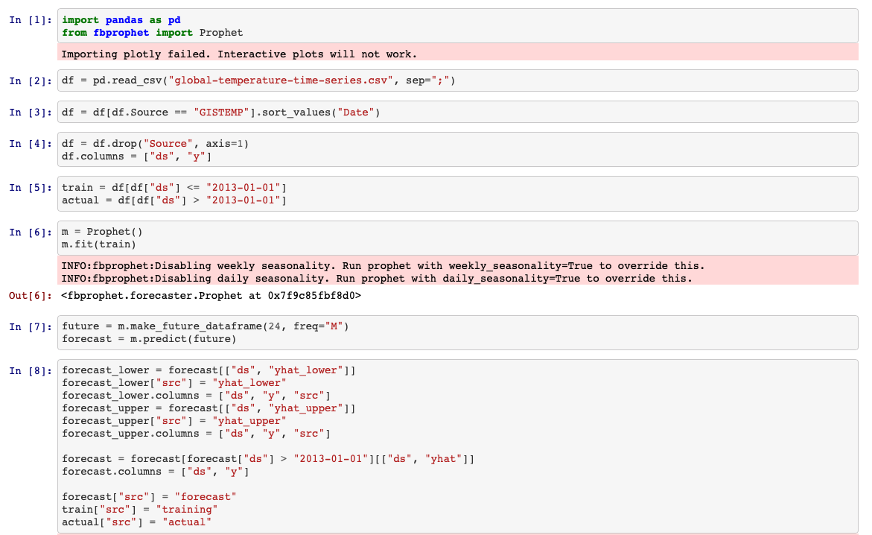
Time series forecasting in Tableau
In addition, Tableau can also visualize forecasts from external tools.
In this case, Prophet was used via Python (see inset) to forecast the global average temperature deviation based on meteorological data from 1880 to 2013.
Actual values are displayed for the forecast period in blue, with the forecast value displayed in orange and the 95% confidence interval, based on a linear model, in green and teal.

